Slide 1
Lecture 12 Clustering, K-Means and EM
EE-uy 4563/El-GY 9123: Introduction to machine learning
Prof. Sundeep rangan, Modified by Yao Wang

Slide 2
Outline
Motivating Example: Document clustering
K-means
K-means for document clustering
Latent semantic analysis (Review of PCA)
Gaussian Mixture models (GMMs)
Expectation Maximization (EM) fitting of GMMs
Other clustering methods
Bag of words representation

Slide 3

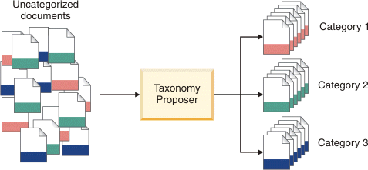
Document Clustering
Data mining
Often have huge numbers of documents
How can we organize this?
Key idea: documents are often in clusters
Can we detect these clusters?
Can be a lucrative service
See IBM service to left

Slide 4
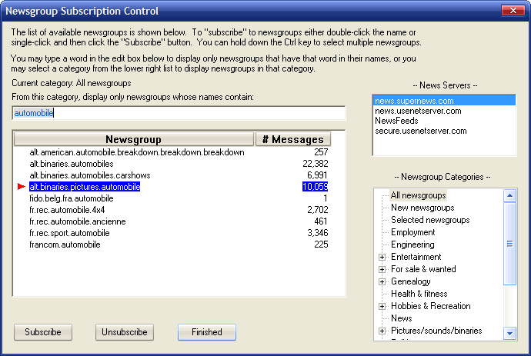
UseNet Newsgroups
Began in late 1970s
Discussion groups for various topics
Started on early university networks
Migrated to Internet
Peaked in 1990s
Useful for studying clustering
Simple documents
“ground truth”: Docs have categories

Slide 5
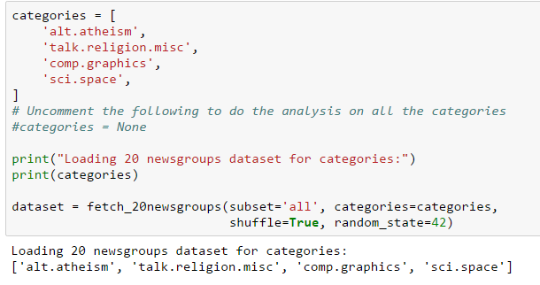
Loading the Data
See demo_doc_cluster.ipynb
Taken from http://scikit-learn.org/stable/auto_examples/text/document_clustering.html
Newsgroups built into sklearn

Slide 6
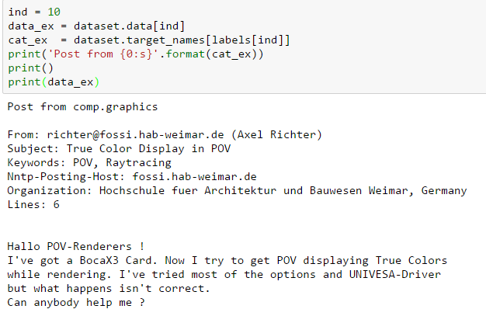
A Typical Newsgroup Post
Data for the posts are in:
Dataset.data
Dataset.labels
Dataset.target_names

Slide 7
Outline
Motivating Example: Document clustering
K-means
K-means for document clustering
Latent semantic analysis
Gaussian Mixture models (GMMs)
Expectation Maximization (EM) fitting of GMMs
Other clustering methods
Bag of words representation

Slide 8
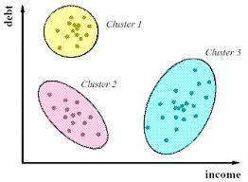
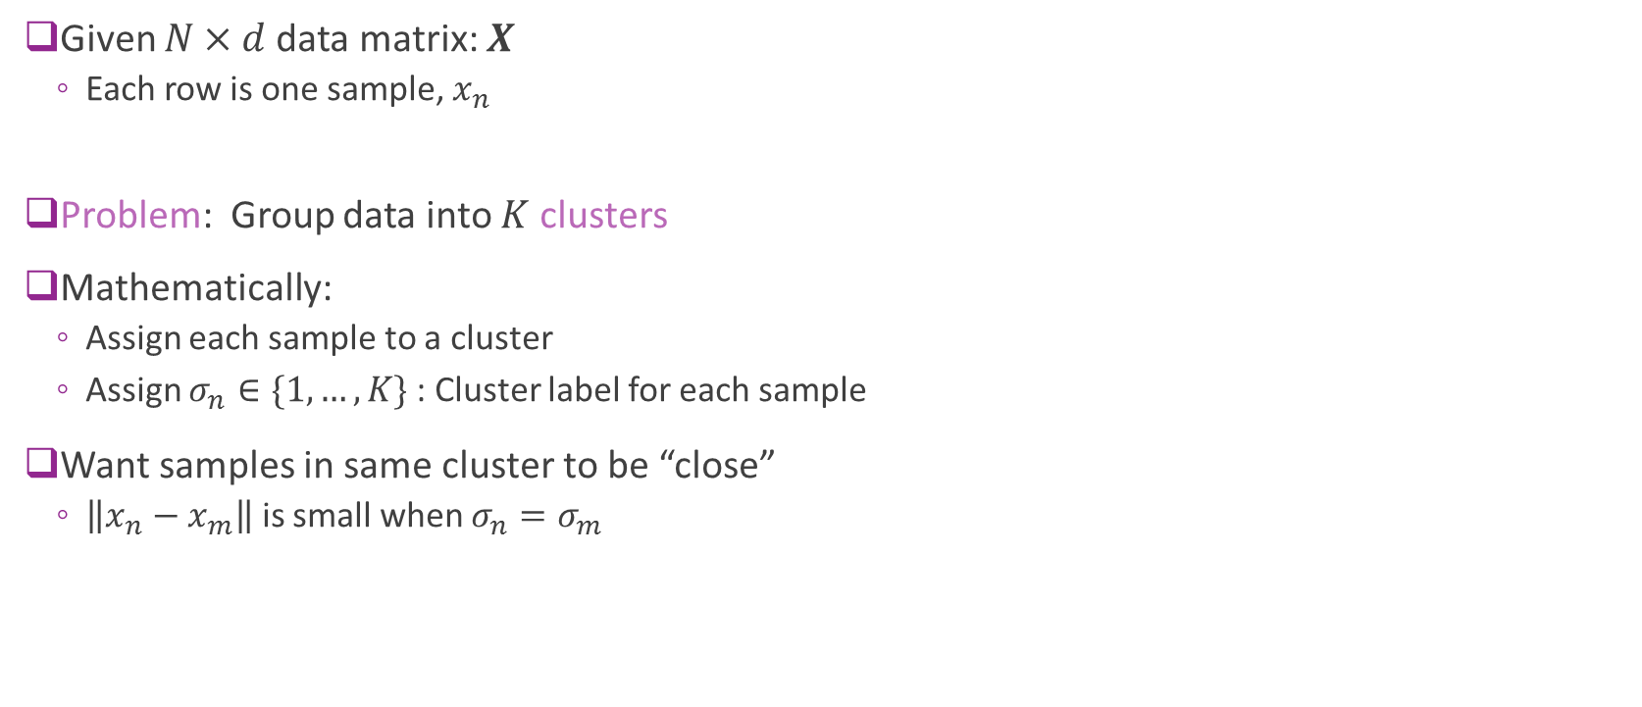
Clustering
Given $N×d$data matrix: $X$
Each row is one sample, $x_{n}$
Problem: Group data into $K$ clusters
Mathematically:
Assign each sample to a cluster
Assign $σ_{n}∈\{1,…, K\}$ : Cluster label for each sample
Want samples in same cluster to be “close”
$\left\|x_{n}−x_{m}\right\|$ is small when $σ_{n}=σ_{m}$

Slide 9
Clustering
Clustering has many applications
Any time you want to segment data
Uncovering latent discrete variables
Examples:
Segmenting sections of an image
Segmenting customers in market data
From: Market segmentation possibilities in the tourism market context of South Africa

Slide 10
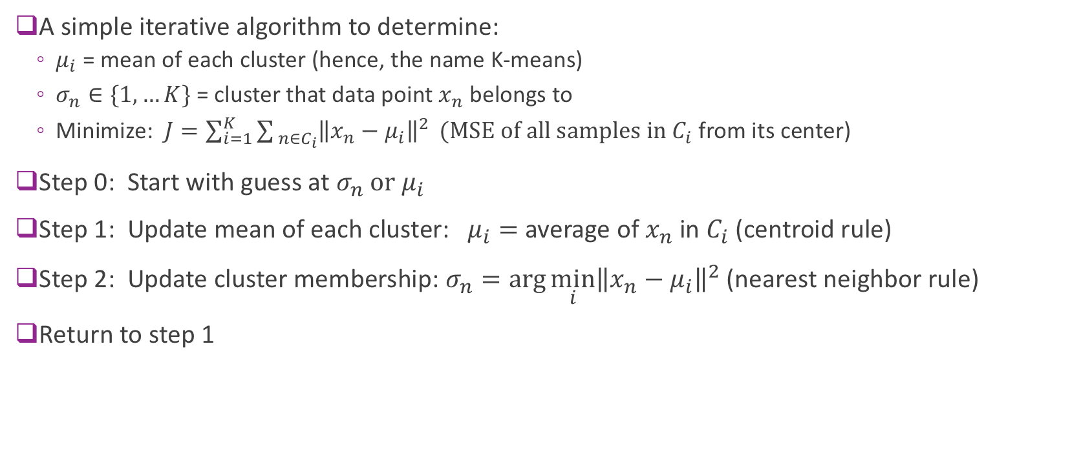
K-means
A simple iterative algorithm to determine:
$μ_{i}$ = mean of each cluster (hence, the name K-means)
$σ_{n}∈\{1,…K\}$ = cluster that data point $x_{n}$ belongs to
Minimize: $J=\sum_{i=1}^{K}{\sum_{ n∈C_{i}}{{\left\|x_{n}−μ_{i}\right\|}^{2}}} (MSE of all samples in C_{i}$ from its center)
Step 0: Start with guess at $σ_{n} or μ_{i}$
Step 1: Update mean of each cluster: $μ_{i}=$ average of $x_{n}$ in $C_{i}$ (centroid rule)
Step 2: Update cluster membership: $σ_{n}=\arg{\min_{i}{{\left\|x_{n}−μ_{i}\right\|}^{2}}}$ (nearest neighbor rule)
Return to step 1

Slide 11
K-Means illustrated
From Bishop, Chapter 9.
K-Means on “old faithful” data set

Slide 12
Image Segmentation Based on Color
Also from Bishop.
Use K-means on the RGB values (dimension = 3)

Slide 13
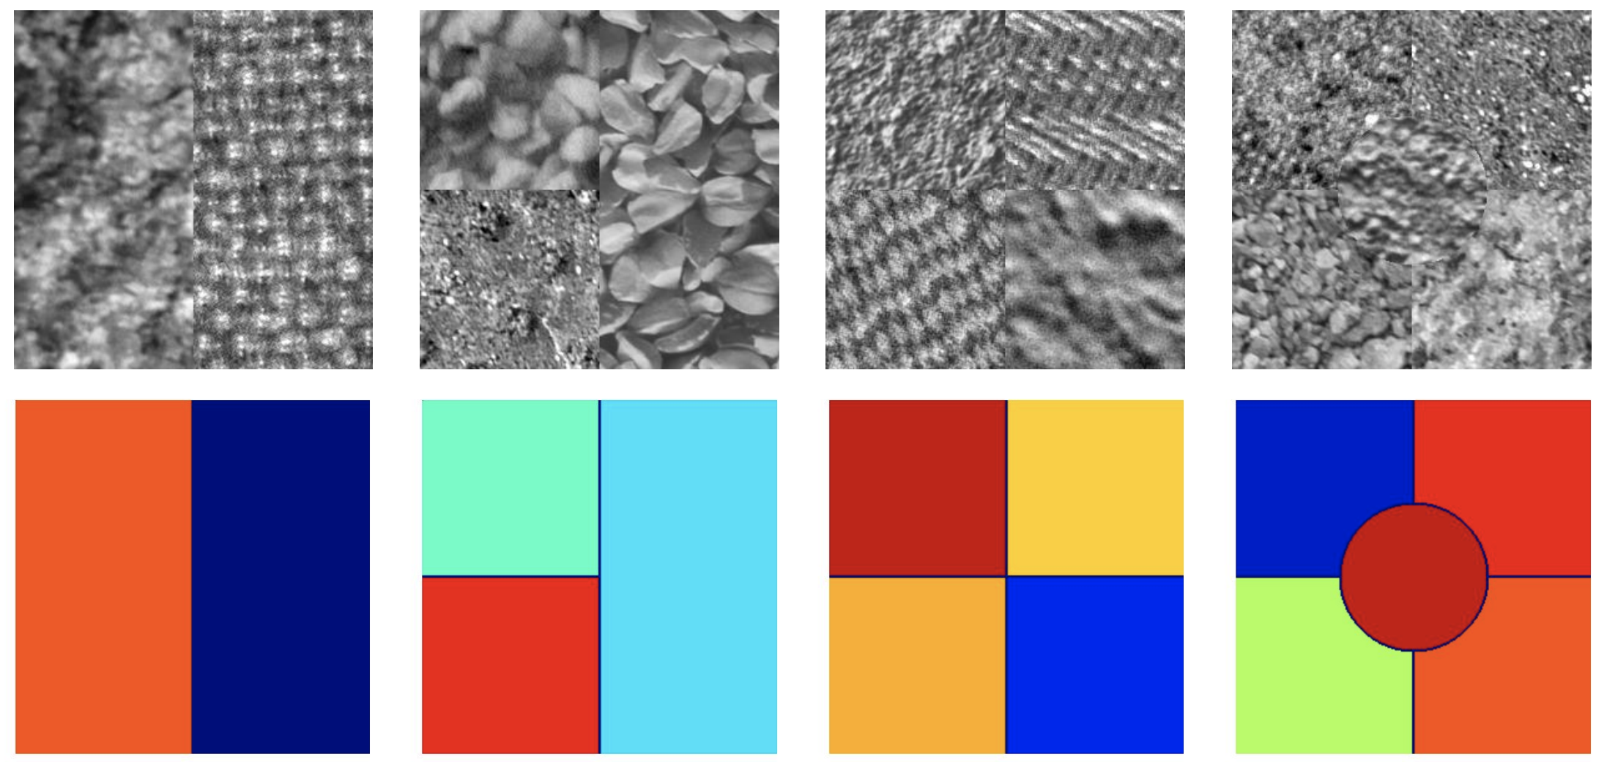
Image segmentation based on texture
Texture at each pixel is usually described by some statistics of the neighborhood surrounding the pixel.

Slide 14
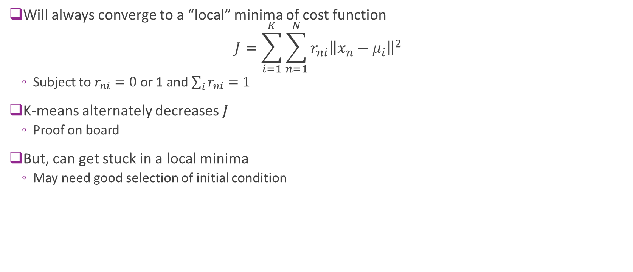
Convergence
Will always converge to a “local” minima of cost function $J=\sum_{i=1}^{K}{\sum_{n=1}^{N}{r_{ni}{\left\|x_{n}−μ_{i}\right\|}^{2}}}$
Subject to $r_{ni}=0$or 1 and $\sum_{i}{r_{ni}=1}$
K-means alternately decreases $J$
Proof on board
But, can get stuck in a local minima
May need good selection of initial condition

Slide 15

Distance measures
Distance measures
How to measure similarity between samples?
Above algorithms used squared distance $\left\|x_{n}−x_{m}\right\|$
Many possibilities
What features to use?
Should you normalize entries?
What distance metric should you use?

Slide 16
Initialization
Initialization:
Final limit of K-means depends on initial condition
May obtain poor clustering with bad initial condition
Possible solutions:
K-means++: http://ilpubs.stanford.edu:8090/778/1/2006-13.pdf
Provides good initial condition based on data
Multiple initial starts

Slide 17
Outline
Motivating Example: Document clustering
K-means
K-means for document clustering
Latent semantic analysis
Gaussian Mixture models (GMMs)
Expectation Maximization (EM) fitting of GMMs
Other clustering methods
Bag of words representation

Slide 18
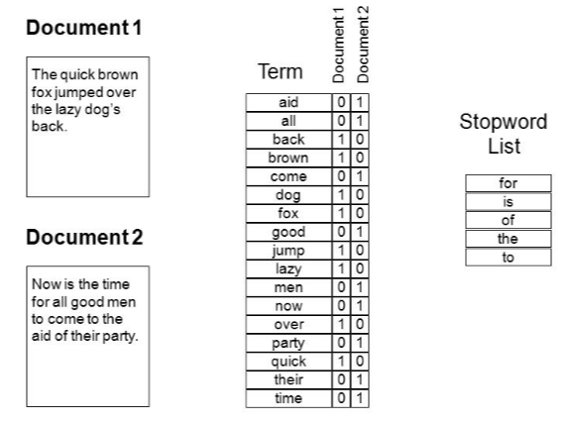
Bag of Words
Document is natively text
Must represent as a numeric vector
Represent by word counts
Enumerate all words
Each document is count of frequencies
Stopwords
Very common words
Not informative

Slide 19
Discussion Questions
Is the absolute number of times a word appears the correct metric?
What about the length of the document?
What about the frequency of the word?
What words “matter”?

Slide 20



Term Frequency – Inverse Document Frequency
Use TF-IDF weight for vectors: $X[n,i]= TF_{i,n} × IDF_{i}$
Document weight vector
Term frequency
$$=\frac{\text{num} \text{times} \text{word} i \text{in} \text{doc} n}{\text{total} \text{num} \text{words} \text{in} \text{doc} n}$$
Inverse doc frequency
$$=\log\left[\frac{Total num docs in corpus}{Num docs with word i}\right]$$

Slide 21
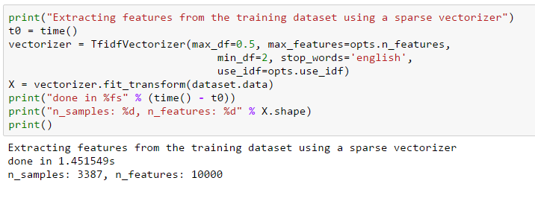
Computing TF-IDF in Python
Can compute the TF-IDF using sklearn functions

Slide 22
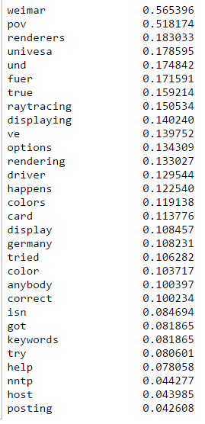
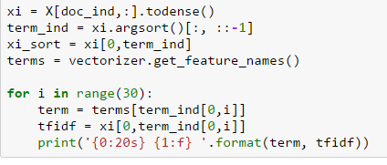
Typical TF-IDF scores
Code to display terms with highest scores

Slide 23
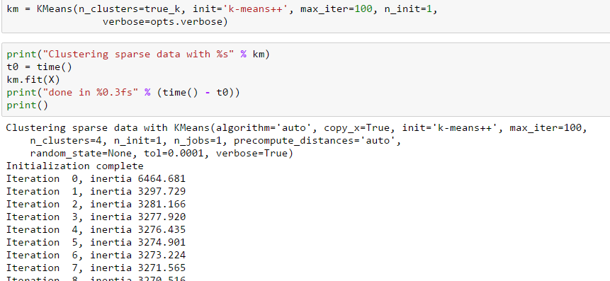
Running K-Means
Use Python built-in function

Slide 24
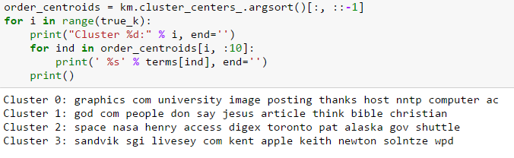
Plotting the Results
Most important words in each cluster
Highest weights in cluster centers

Slide 25
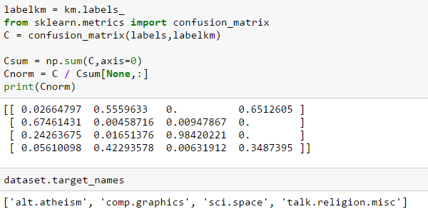
Confusion Matrix
Estimated clusters vs. true categories
Can you see where it got confused?

Slide 26
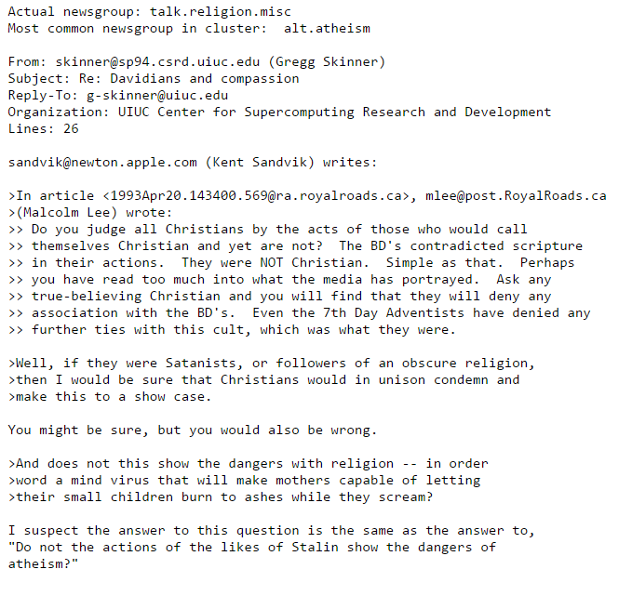
An Example “Wrong” cluster
Post is from talk.religion.misc
Placed in cluster with mostly alt.atheism

Slide 27
Outline
Motivating Example: Document clustering
K-means
K-means for document clustering
Latent semantic analysis
Gaussian Mixture models (GMMs)
Expectation Maximization (EM) fitting of GMMs
Other clustering methods
Bag of words representation

Slide 28
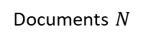

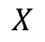
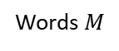
Need for Dimensionality Reduction
Term-document matrix $X$ is large
$N$documents $×M$ words in vocabulary
$M$ is large
Can be ${10}^{6}$ in commercial systems
Document represented by long sparse vector
Inefficient
Need dimensionality reduction
Words $M$
Documents $N$
$$X$$

Slide 29
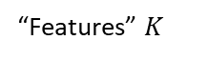
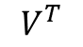

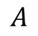
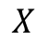
Latent Semantic Analysis (PCA revisited!)
LSA = PCA on term-document matrix
$X≈USV^{T}=AV^{T}, A=US$
$U,S,V^{T}$ computed by low-rank SVD
Words $M$
“Features” $K$
Words $M$
Words $M$
$$V^{T}$$
Documents $N$
=
$$A$$
$$X$$

Slide 30
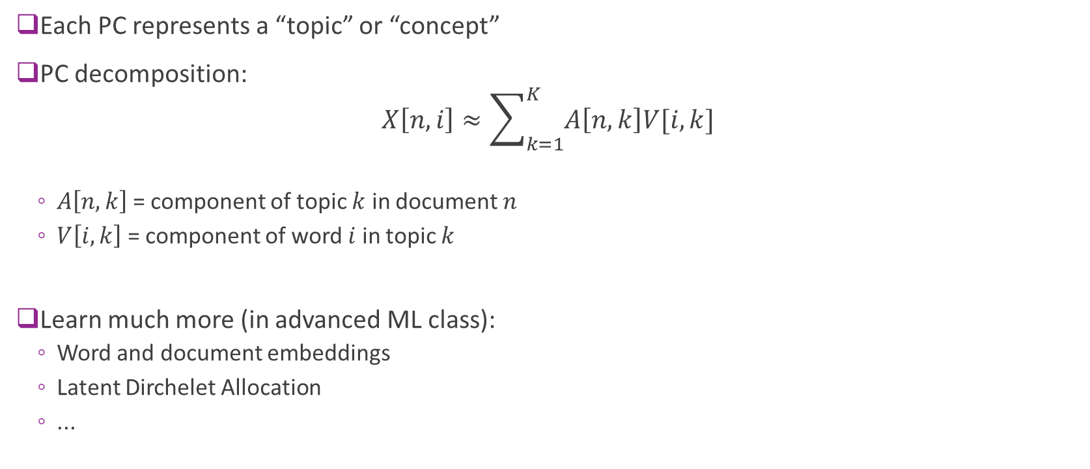
LSA Interpretation
Each PC represents a “topic” or “concept”
PC decomposition: $X\left[n,i\right]≈\sum_{k=1}^{K}{A\left[n,k\right]V[i,k]}$
$A\left[n,k\right]$ = component of topic $k$ in document $n$
$V\left[i,k\right]$ = component of word $i$ in topic $k$
Learn much more (in advanced ML class):
Word and document embeddings
Latent Dirchelet Allocation
...

Slide 31
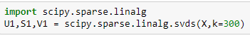
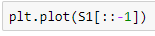
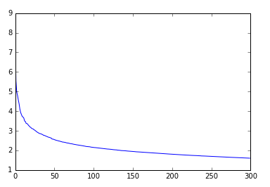
Perform LSA on NewsGroup
Use sparse SVD
Much faster
Concentration of variance in small number of PCs
More interesting results in larger corpi

Slide 32
Demo: color quantization using k-means

Slide 33
Outline
Motivating Example: Document clustering
K-means
K-means for document clustering
Latent semantic analysis
Gaussian Mixture models (GMMs)
Expectation Maximization (EM) fitting of GMMs
Other clustering methods
Bag of words representation

Slide 34
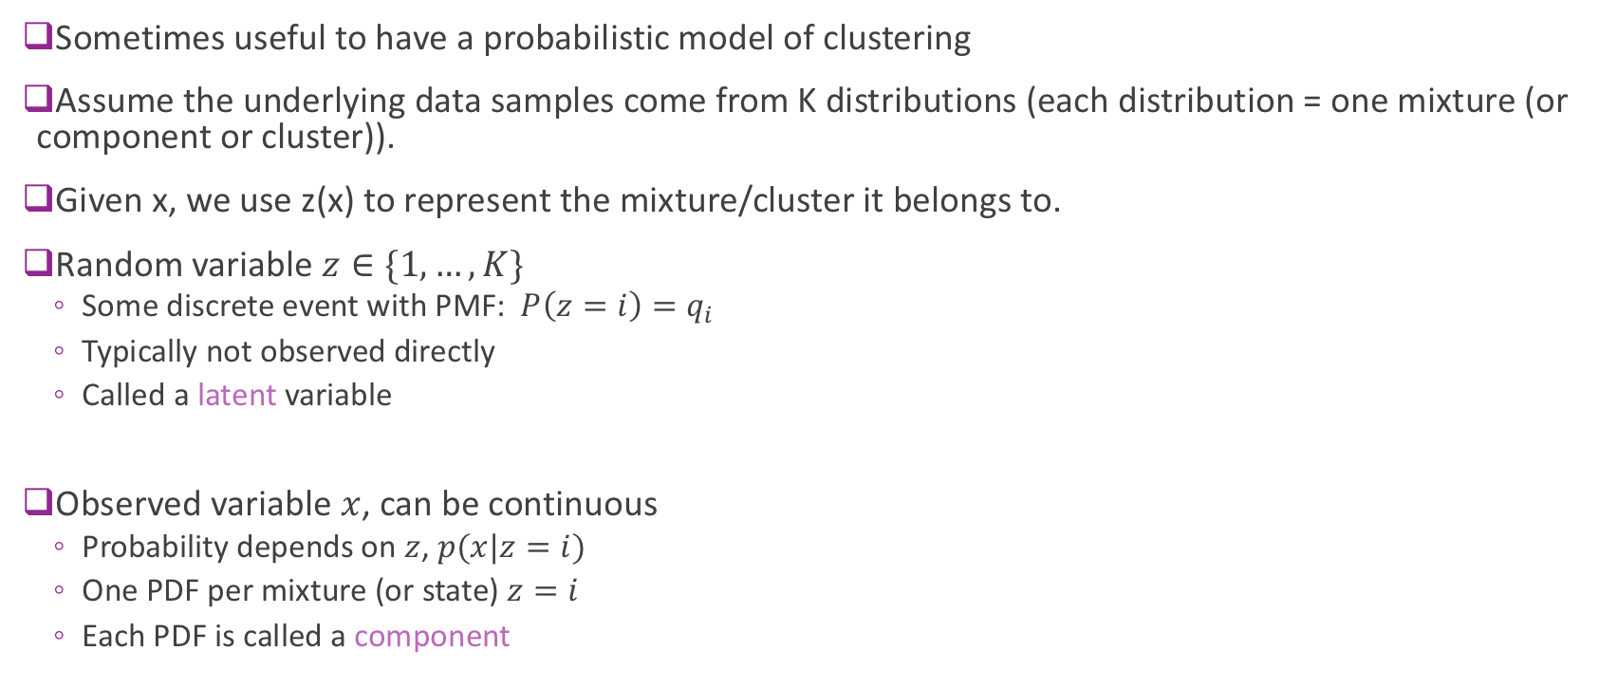
Mixture Models
Sometimes useful to have a probabilistic model of clustering
Assume the underlying data samples come from K distributions (each distribution = one mixture (or component or cluster)).
Given x, we use z(x) to represent the mixture/cluster it belongs to.
Random variable $z∈\{1,…,K\}$
Some discrete event with PMF: $P\left(z=i\right)=q_{i}$
Typically not observed directly
Called a latent variable
Observed variable $x$, can be continuous
Probability depends on $z$, $p(x|z=i)$
One PDF per mixture (or state) $z=i$
Each PDF is called a component

Slide 35
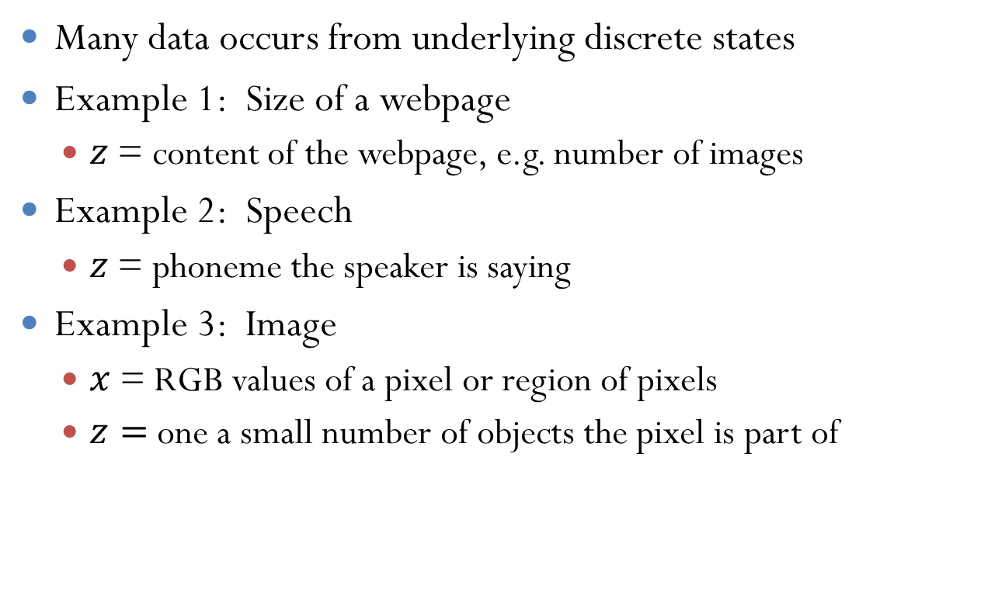
Examples
Many data occurs from underlying discrete states
Example 1: Size of a webpage
$z$ = content of the webpage, e.g. number of images
Example 2: Speech
$z$= phoneme the speaker is saying
Example 3: Image
$x$ = RGB values of a pixel or region of pixels
$z=$one a small number of objects the pixel is part of

Slide 36
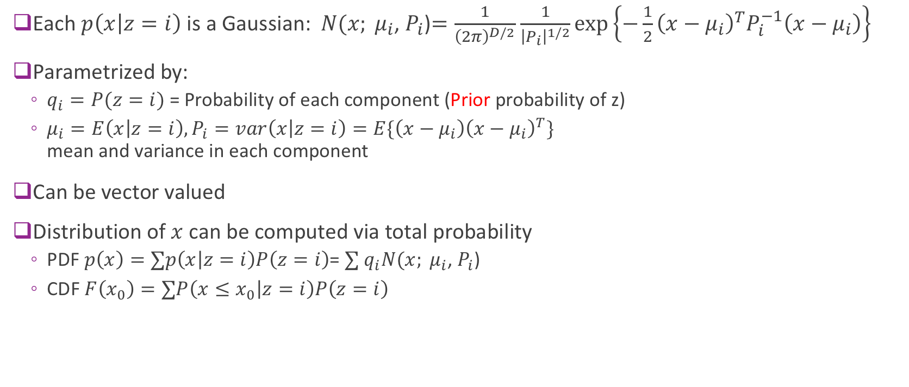
Gaussian Mixture Models
Each $p\left(x | z=i\right)$ is a Gaussian:$N({x; μ}_{i}$, $P_{i}$)$=\frac{1}{{\left(2π\right)}^{D/2}}$ $\frac{1}{{\left|P_{i}\right|}^{1/2}}exp\left\{−\frac{1}{2}{{\left(x−μ_{i}\right)}^{T}P}_{i}^{−1}\left(x−μ_{i}\right)\right\}$
Parametrized by:
$q_{i}=P(z=i)$ = Probability of each component (Prior probability of z)
$μ_{i}=E\left(x | z=i\right), P_{i}=var\left(x | z=i\right)=E\{{\left(x−μ_{i}\right)\left(x−μ_{i}\right)}^{T}\}$ mean and variance in each component
Can be vector valued
Distribution of $x$ can be computed via total probability
PDF $p\left(x\right)=∑p\left(x | z=i\right)P\left(z=i\right)$= $∑$ $q_{i}N({x; μ}_{i}$, $P_{i}$)
CDF $F\left(x_{0}\right)=∑P\left({x≤x}_{0} | z=i\right)P\left(z=i\right)$

Slide 37
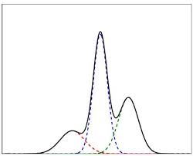
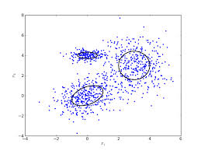
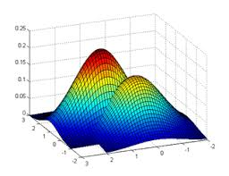
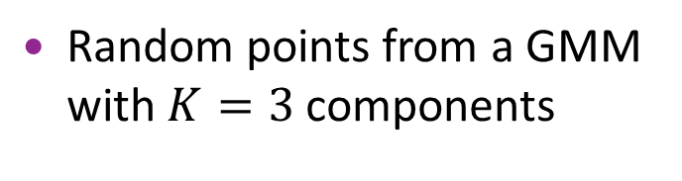

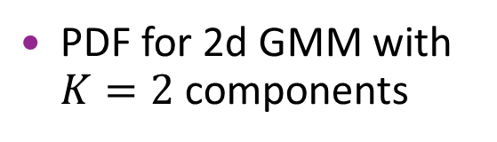
Visualizing GMMs
1d model with $K=3$ components
PDF for 2d GMM with $K=2$ components
Random points from a GMM with $K=3$ components

Slide 38
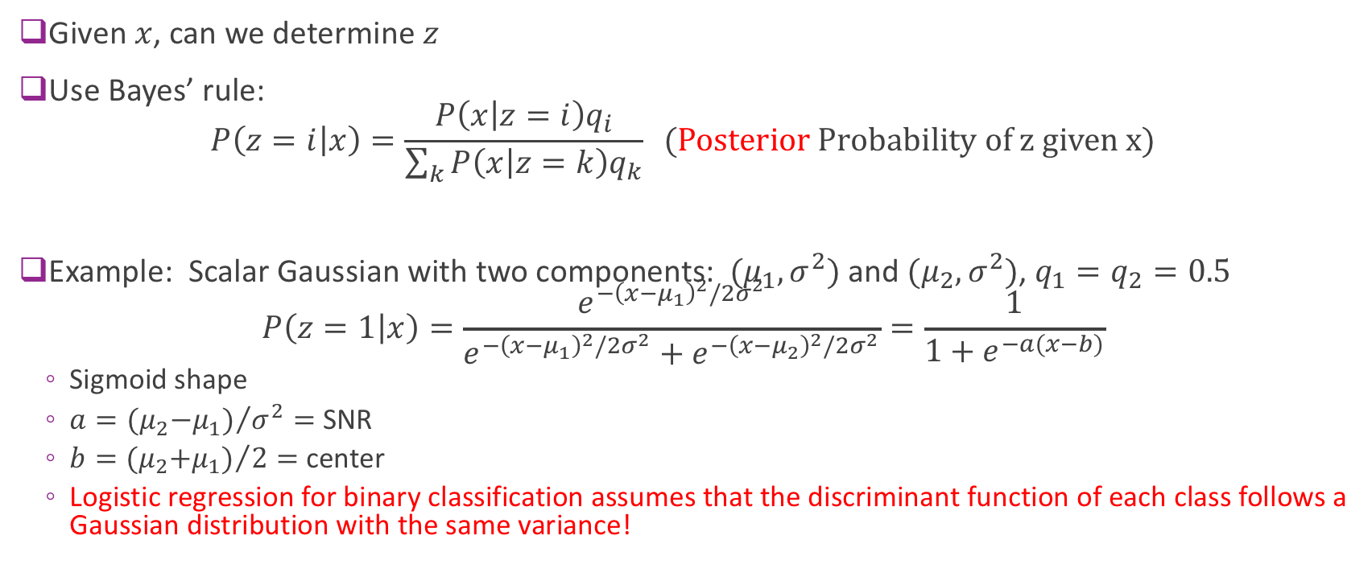
Determining the Component
Given $x$, can we determine $z$
Use Bayes’ rule: $P\left(z=i | x\right)=\frac{P\left(x | z=i\right)q_{i}}{\sum_{k}{P\left(x | z=k\right)q_{k}}} (Posterior Probability of z given x)$
Example: Scalar Gaussian with two components: $(μ_{1},σ^{2})$ and $(μ_{2},σ^{2})$, $q_{1}=q_{2}=0.5$ $P\left(z=1 | x\right)=\frac{e^{−{\left(x−μ_{1}\right)}^{2}/2σ^{2}}}{e^{−{\left(x−μ_{1}\right)}^{2}/2σ^{2}}+e^{−{\left(x−μ_{2}\right)}^{2}/2σ^{2}}}=\frac{1}{1+e^{−a(x−b)}}$
Sigmoid shape
$a={{(μ}_{2}−μ_{1})}/{σ^{2}}=$ SNR
$b={{(μ}_{2}+μ_{1})}/2=$ center
Logistic regression for binary classification assumes that the discriminant function of each class follows a Gaussian distribution with the same variance!

Slide 39
Outline
Motivating Example: Document clustering
K-means
K-means for document clustering
Latent semantic analysis
Gaussian Mixture models (GMMs)
Expectation Maximization (EM) fitting of GMMs
Other clustering methods
Bag of words representation

Slide 40
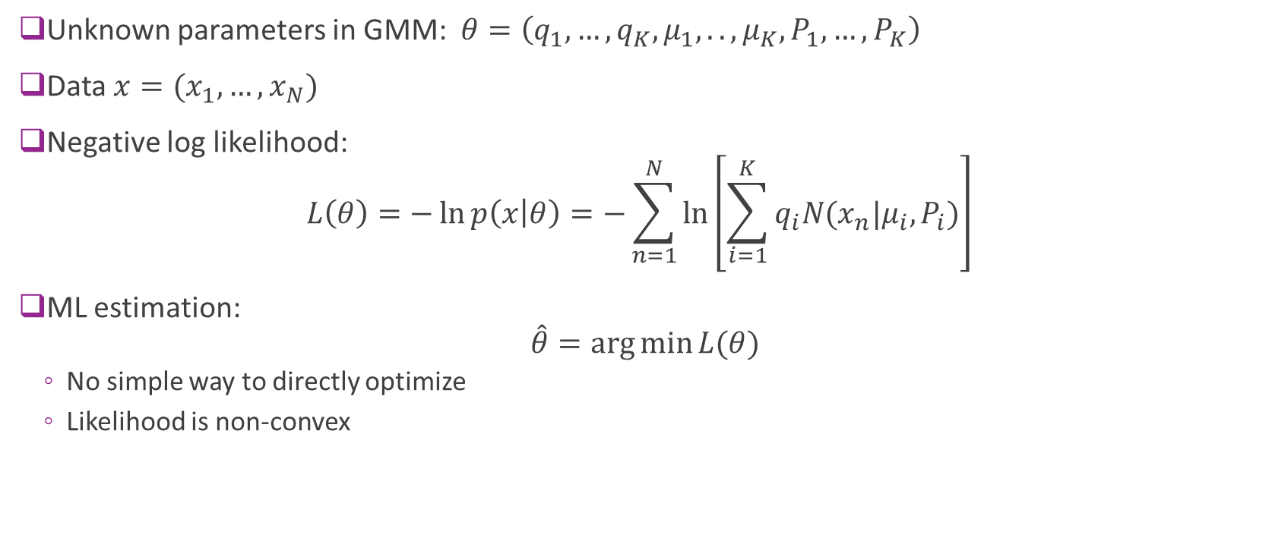
Maximum Likelihood Estimation
Unknown parameters in GMM: $θ=\left(q_{1},…,q_{K},μ_{1},..,μ_{K},P_{1},…,P_{K}\right)$
Data $x=(x_{1},…,x_{N})$
Negative log likelihood: $L\left(θ\right)=−\ln{p\left(x | θ\right)}=−\sum_{n=1}^{N}{\ln\left[\sum_{i=1}^{K}{q_{i}N(x_{n}|μ_{i},P_{i})}\right]}$
ML estimation: $\hat{θ}=\arg{\min{L(θ)}}$
No simple way to directly optimize
Likelihood is non-convex

Slide 41
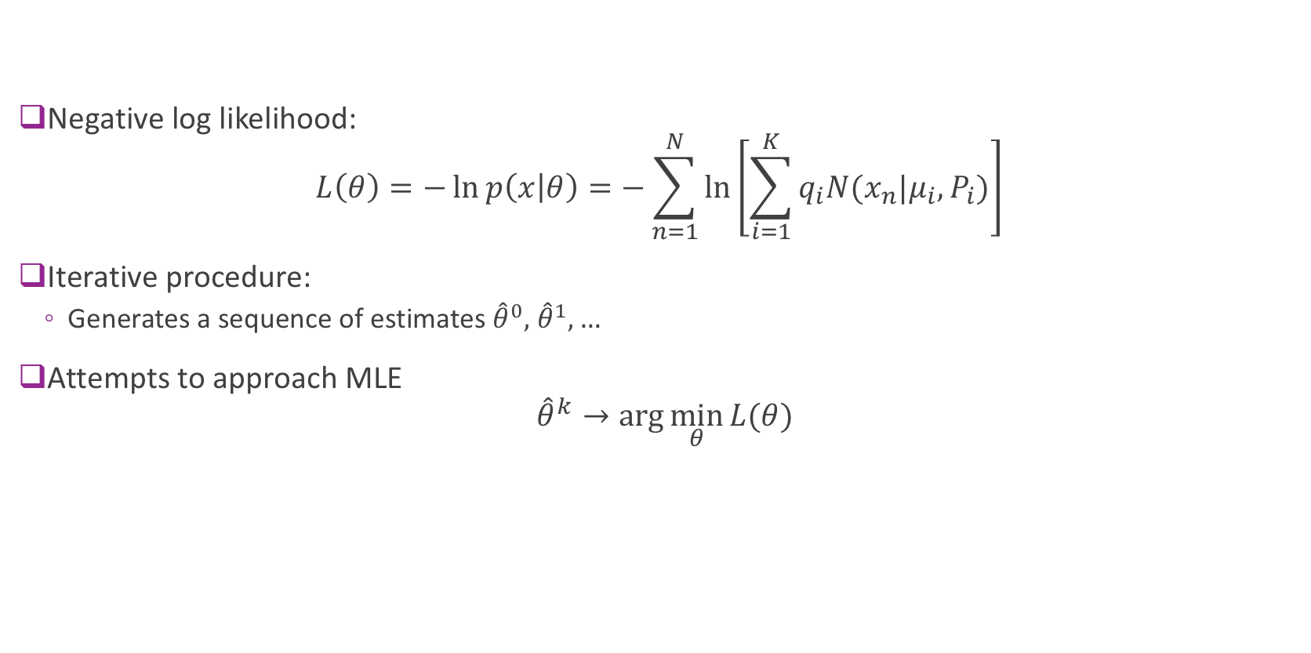
Expectation Maximization
Negative log likelihood: $L\left(θ\right)=−\ln{p\left(x | θ\right)}=−\sum_{n=1}^{N}{\ln\left[\sum_{i=1}^{K}{q_{i}N(x_{n}|μ_{i},P_{i})}\right]}$
Iterative procedure:
Generates a sequence of estimates ${\hat{θ}}^{0},$ ${\hat{θ}}^{1},…$
Attempts to approach MLE ${\hat{θ}}^{k}→\arg{\min_{θ}{L(θ)}}$

Slide 42

EM Steps
E-step: Estimate the latent variables z (E= expectation)
Find the posterior of the latent variables given ${\hat{θ}}^{k}$:${ γ}_{ni}=P\left(z=i | x_{n},θ={\hat{θ}}^{k}\right)$
M-step: Update parameters to minimize $L\left(θ\right)$ (M= maximization) ${\hat{θ}}^{k+1}=\arg{\max_{θ}{Q\left(θ,{\hat{θ}}^{k}\right)}}$

Slide 43

E-Step for a GMM: Finding the posterior
Given parameters $q_{i}, μ_{i},P_{i}$
Find posterior by Bayes rule
$$γ_{ni}=P\left(z_{n}=i | x_{n}\right)=\frac{P\left(x_{n} | z_{n}=i\right)q_{i}}{\sum_{k}{P\left(x_{n} | z_{n}=k\right)q_{k}}} =\frac{N\left(x_{n} | μ_{i},P_{i}\right)q_{i}}{\sum_{k}{N\left(x_{n} | μ_{k},P_{k}\right)q_{k}}}$$
A “soft” selection

Slide 44
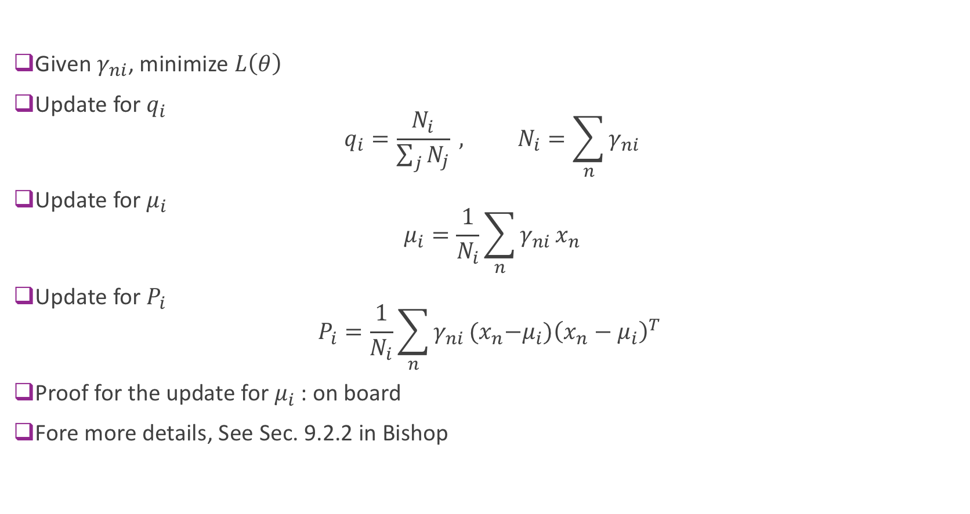
M-Step for the GMM
Given $γ_{ni}$, minimize $L\left(θ\right)$
Update for $q_{i}$ $q_{i}=\frac{N_{i}}{\sum_{j}{N_{j}}} , N_{i}=\sum_{n}{γ_{ni}}$
Update for $μ_{i}$ $μ_{i}=\frac{1}{N_{i}}\sum_{n}{γ_{ni}}x_{n}$
Update for $P_{i}$ $P_{i}=\frac{1}{N_{i}}\sum_{n}{γ_{ni}}{(x}_{n}−μ_{i}){\left(x_{n}−μ_{i}\right)}^{T}$
Proof for the update for $μ_{i}$: on board
Fore more details, See Sec. 9.2.2 in Bishop

Slide 45
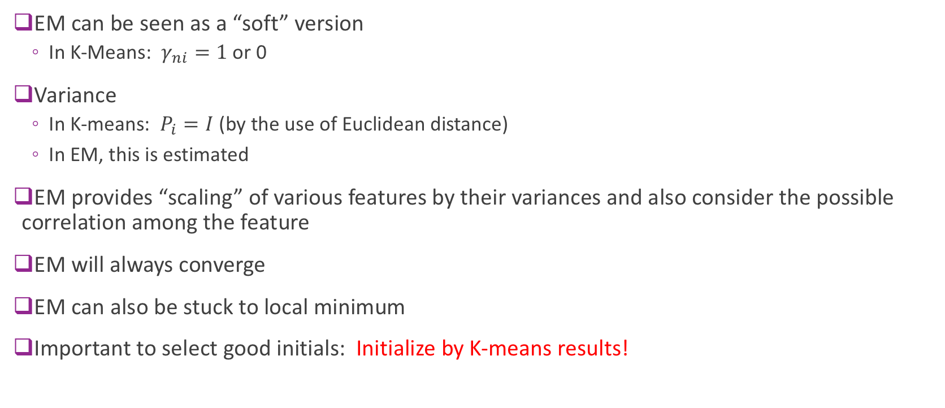
Relation to K-Means
EM can be seen as a “soft” version
In K-Means: $γ_{ni}=1$or 0
Variance
In K-means: $P_{i}=I$ (by the use of Euclidean distance)
In EM, this is estimated
EM provides “scaling” of various features by their variances and also consider the possible correlation among the feature
EM will always converge
EM can also be stuck to local minimum
Important to select good initials: Initialize by K-means results!

Slide 46
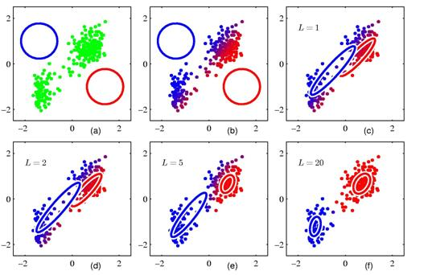
EM Illustrated
Simple example with K=2 clusters
Dimension = 2
Can have bad convergence from poor initial condition
Fig. 9.8 in Bishop

Slide 47
K-Means illustrated
From Bishop, Chapter 9.
K-Means on “old faithful” data set

Slide 48
EM via sklearn
http://scikit-learn.org/stable/modules/generated/sklearn.mixture.GaussianMixture.html#sklearn.mixture.GaussianMixture
class sklearn.mixture.GaussianMixture(n_components=1, covariance_type=’full’, tol=0.001, reg_covar=1e-06, max_iter=100, n_init=1, init_params=’kmeans’, weights_init=None, means_init=None, precisions_init=None, random_state=None, warm_start=False, verbose=0, verbose_interval=10)[source]¶
covariance_type : {‘full’, ‘tied’, ‘diag’, ‘spherical’},
'full' (each component has its own general covariance matrix), 'tied' (all components share the same general covariance matrix), 'diag' (each component has its own diagonal covariance matrix), 'spherical' (each component has its own single variance).
Example:
http://scikit-learn.org/stable/auto_examples/mixture/plot_gmm_covariances.html#sphx-glr-auto-examples-mixture-plot-gmm-covariances-py

Slide 49
Demo: Color quantization using GMM
Quantize to 16 colors only
Kmeans_GMM_color_quantization.ipynb

Slide 50
How to determine the number of clusters?
Brute force:
Evaluate the cost function for different candidate numbers, on the validation set
Other methods

Slide 51
Other clustering methods
K-means and EM must know the number of clusters
To determine the ”optimal” number: Evaluate the cost function for different candidate numbers, on the validation set
Clustering methods that can determine the number of clusters automatically
Mean-shift (mode-seeking)
Dirichlet Process Mixture Model
Affinity propagation
…
What features to use?
Application dependent
PCA can be used for feature dimension reduction
Non-linear feature learning: Spectral clustering

Slide 52

Examples in sklearn
http://scikit-learn.org/stable/auto_examples/cluster/plot_cluster_comparison.html#sphx-glr-auto-examples-cluster-plot-cluster-comparison-py

Slide 53
Deep learning for clustering (unsupervised learning)
DEEP EMBEDDED CLUSTERING (DEC)
Using an auto encoder to learn the latent features, which are then clustered by k-means
DEEP CLUSTERING NETWORK (DCN)
The network is trained using sum of the signal reconstruction error and the clustering loss after k-means
CLUSTERING CNN (CCNN)
Using Generative network
From: Clustering with Deep Learning: Taxonomy and New Methods, Elie Aljalbout, Vladimir Golkov, Yawar Siddiqui, Daniel Cremers, https://arxiv.org/pdf/1801.07648.pdf

Slide 54
Other applications of clustering
Image/signal compression
Each image block is “quantized” to one cluster pattern, and the entire block is described by the cluster index
Image segmentation
Each pixel is described by a color/texture descriptor and classified into one of the clusters
Image/signal classification through “Bad of Words” representation

Slide 55

Bag of Visual Words for Image Classification
From http://www.cs.cmu.edu/~16385/lectures/Lecture12.pdf

Slide 56

BoW Pipeline for Image Classification
From http://www.cs.cmu.edu/~16385/lectures/Lecture12.pdf

Slide 57

At every shifted patch or detect feature points
Use SIFT, HOG, or other descriptors
From http://www.cs.cmu.edu/~16385/lectures/Lecture12.pdf

Slide 58

How to deduce these words ?
From http://www.cs.cmu.edu/~16385/lectures/Lecture12.pdf

Slide 59

Find the dictionary atom that is closest to the original feature
(nearest neighbor search)
From http://www.cs.cmu.edu/~16385/lectures/Lecture12.pdf

Slide 60

From http://www.cs.cmu.edu/~16385/lectures/Lecture12.pdf

Slide 61
How to Learn Visual Dictionary?
Assume you have feature vectors extracted from many training images
Apply K-means to all training feature vectors!
The training images should encompass categories to be classified
How to select initial centroids?
How to determine K?
Can you use EM instead?
Would EM be better?

Slide 62

“words” from people
From http://www.cs.cmu.edu/~16385/lectures/Lecture12.pdf
From http://www.cs.cmu.edu/~16385/lectures/Lecture12.pdf

Slide 63

“Words” from cars
From http://www.cs.cmu.edu/~16385/lectures/Lecture12.pdf

Slide 64

Histogram of Visual Words
Count how many times each “word” appears in an image -> Histogram of words
Can you tell the image types from the following histograms?
From http://www.cs.cmu.edu/~16385/lectures/Lecture12.pdf

Slide 65
How to Classify Images?
Use the histogram of words as the descriptor for an image
Train a classifier (e.g. Support Vector Machine) from training images
The most successful image classification method before deep learning ….

Slide 66
What you should know from this lecture
What is clustering?
Unsupervised!
K-means method
GMM method
Relationship between K-means and GMM
Sensitivity of K-means/GMM to initial conditions
Bag of words representation

